Slide 1
Service Learning Project
Dayana Juarez

Slide 2
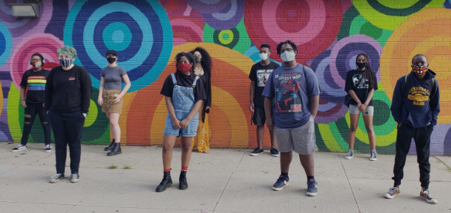
Mint Artists Guild
A nonprofit organization
Based in Palmer Park
They guide talented Detroit teen artists to learn, grow and thrive in creative careers and serve their communities
Their Programs :
Learn & Earn - artists learn how to price, promote, & sell their art
Summer Creative Jobs- artists put their creative & entrepreneurial skills into action through paid work opportunities
Paint Detroit with Generosity- artists partner with local organizations to design and enhance community spaces

Slide 3
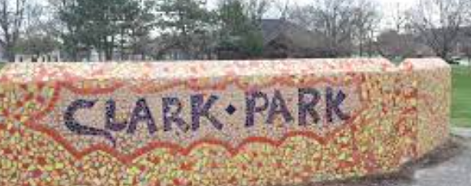
Leader for Art in the Park
Placed in 2 different Parks
Sponsored by the Pistons
Fridays 11-12:30pm Clark Park
Sundays 1-2:30 pm Monroe St Midway downtown
Had a bin with all supplies- pencils, markers, paper, coloring sheets
Kept track of the people who attended
Filled a google form at the end - report- upload pics, include the number of people, what work/ didn’t work, any materials

Slide 4
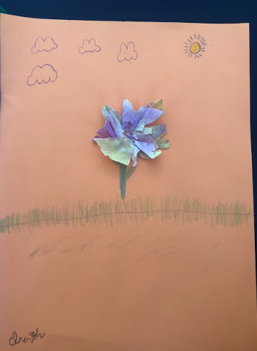
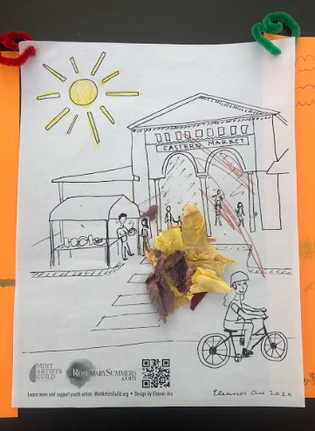
The Co-founder would come up with the crafts
I was free to do my own crafts

Slide 5
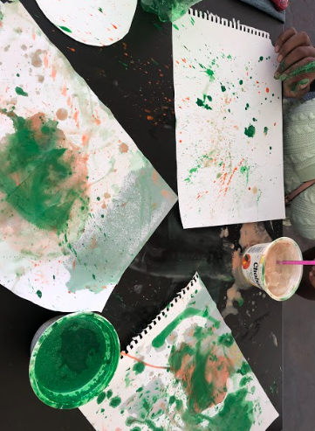
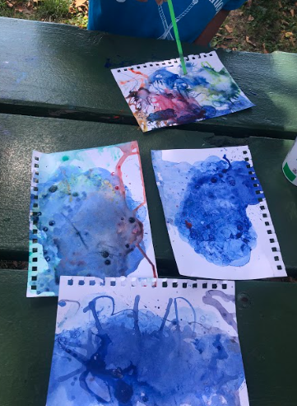

Slide 6
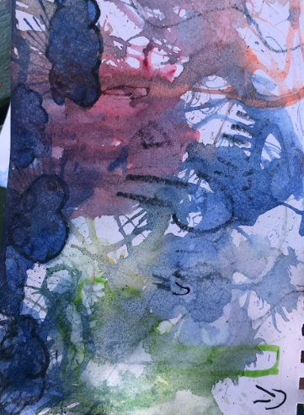

Slide 7
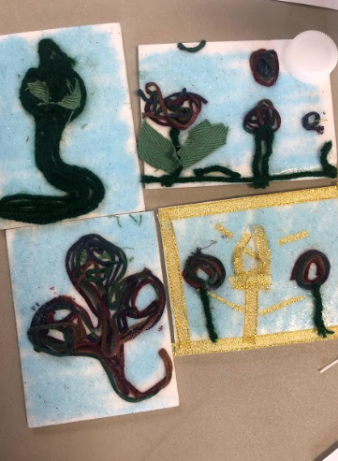
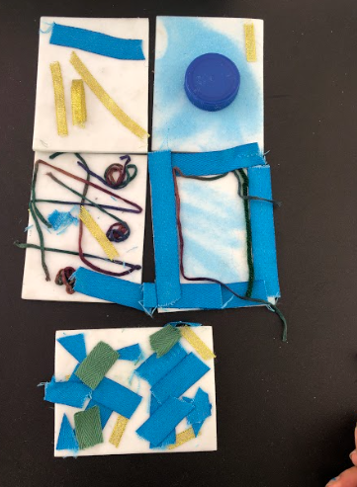

Slide 8
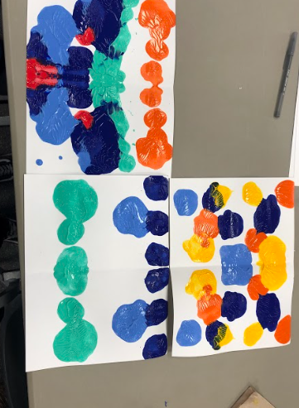
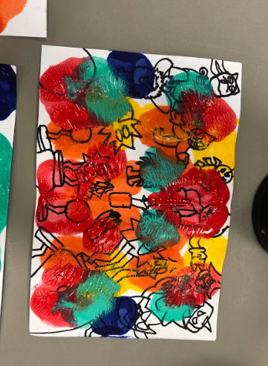

Slide 9
